Slide 1
How to succeed in AICE Global Perspectives A level
By: Genesis Rodriguez-Rodriguez

Slide 2
FIRST THINGS FIRST...
IF YOU ARE HUUUUUUGE PROCRASTINATOR.... get up go to the AICE office and change your schedule
If you think you will change your procrastination ways YOUR SENIOR YEAR in high school, you won't
You will MOST LIKELY be so stressed out about college applications, college decisions, and financial aid that global perspectives will be at the bottom of your priority list

Slide 3
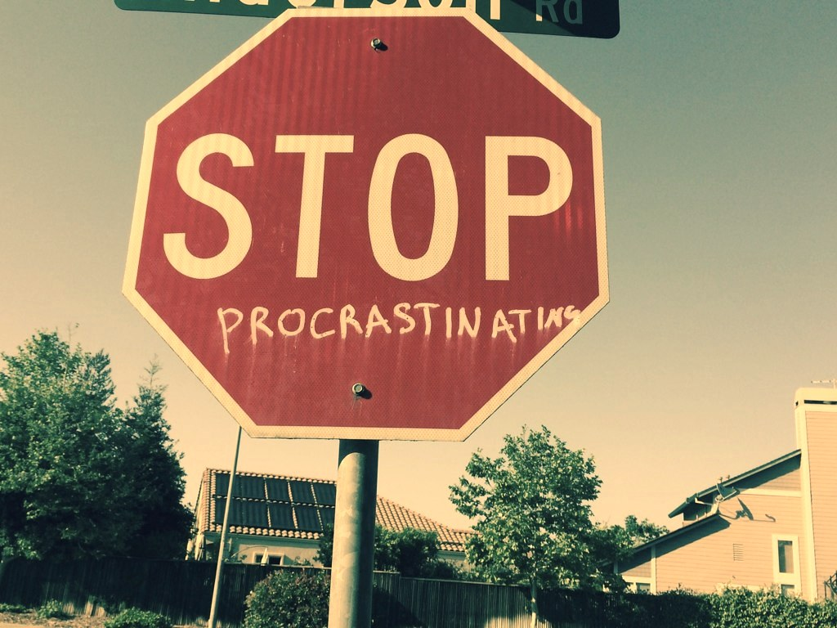
SERIOUSLY... IF YOU ARE A HORRIBLE PROCRASTINATOR.. GET OUT

Slide 4
Deadlines!!!!
This Photo by Unknown author is licensed under CC BY.

Slide 5
Follow all deadlines
Crihfield will give you deadlines for EVERYTHING so make sure you plan ahead to space out your time
No matter who you are, she will give you a 0 for late work (seriously trust me)
ADVICE: give yourself a deadline for each assignment and convince yourself to finish by that date no matter what and it will make turning in your assignment to Crihfield a lot easier

Slide 6
But genesis... how bad will it be if I don’t follow deadlines and I am a procrastinator?
This Photo by Unknown author is licensed under CC BY.

Slide 7
You will cry... a lot
You will stress... a lot
You will feel like a disappointment... a lot

Slide 8
How will I feel if I follow deadlines and only procrastinate a normal amount?
This Photo by Unknown author is licensed under CC BY.

Slide 9
Feelings of awesomeness
You will SUCCEED!
You will be PROUD!!!
You will have a sense of accomplishment!!
You will have finished a real college research paper that you can take with you anywhere!!!!

Slide 10
Pick a topic you love
This Photo by Unknown author is licensed under CC BY.

Slide 11
Same thing applies this year
Just like last year, it is essential you choose a topic you either already love or are truly interesting in learning
You spend the entire year on this topic, and you will have to be interested in it to be motivated
Once you choose a topic you like, it's really cool learning about it and gaining so much knowledge on it
Crihfield will give you a range of topics to stay away from so listen to her because she knows what she is doing

Slide 12
Logs. Logs. logs
This Photo by Unknown author is licensed under CC BY.

Slide 13
Do them.

Slide 14
Advice
If you don't do your logs every day, you will wish you had
There is a good powerpoint on Crihfield's website to follow about logs, go there and follow it and you will succeed

Slide 15
All in all..
If you follow the rules and structure of this class, you will succeed and have fun
You will be proud of yourself and turning in this paper will be one of the satisfying feelings in the world

Slide 16
A LEVEL GLOBAL IS COOL

